Slide 1
API Led
课程目标
Web services and APIs
API lifecycle
Anypoint platform
Design and deploy API without any code
Calling mock service
Chinasofti MuleSoft Training 2017
Notes:
培训说明和Mulesoft总体介绍(15-25分钟)

Slide 2


Web services and APIs
什么是API?
API是协议，是约定，是接口，并且和具体的技术实现无关
Chinasofti MuleSoft Training 2017
Notes:
培训说明和Mulesoft总体介绍(15-25分钟)

Slide 3
Web services and APIs
什么是API?
API is an Application Programming Interface.
It provides the information for how to communicate with a software component, defining the – Operations (what to call) – Inputs (what to send with a call) – Outputs (what you get back from a call) – Underlying data types
Chinasofti MuleSoft Training 2017
Notes:
培训说明和Mulesoft总体介绍(15-25分钟)

Slide 4
Web services and APIs
什么是Web Service?
A web service is a method of communication that allows two software systems to exchange data with some rules over the internet.
There are two main types of web service:
• SOAP web services – Traditional, more complex type – The communication rules are defined in an XML-based WSDL (Web Services Description Language) file
• RESTful web services – Recent, simpler type based on representational state transfer (REST) based communications – Use the existing HTTP communication protocol
Chinasofti MuleSoft Training 2017
Notes:
培训说明和Mulesoft总体介绍(15-25分钟)

Slide 5
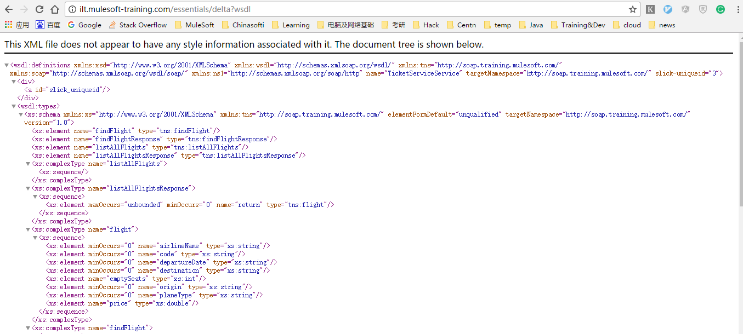
Web services and APIs
SOAP(Simple Object Access Protocol)
Chinasofti MuleSoft Training 2017
Notes:
培训说明和Mulesoft总体介绍(15-25分钟)

Slide 6
Web services and APIs
SOAP(Simple Object Access Protocol)
• getCompanies() • companies() • listCompanies() • getCompaniesByCountry(“France”) • getOneCompany(3) • addCompany(“name”,”address”,…) • deleteCompany(3) • editACompany(3,”new data”)
Chinasofti MuleSoft Training 2017
Notes:
培训说明和Mulesoft总体介绍(15-25分钟)

Slide 7
Web services and APIs
RESTful web services
REST stands for Representational State Transfer
– An architectural style where clients and servers exchange representations of resources using standard HTTP protocol
– The HTTP request method indicates which operation should be performed on the object identified by the URL • GET, POST, DELETE, PUT, PATCH
Chinasofti MuleSoft Training 2017
Notes:
培训说明和Mulesoft总体介绍(15-25分钟)

Slide 8
Web services and APIs
RESTful web services
• Data and resources are represented using URIs • Resources are accessed or changed using a fixed set of operations – GET retrieves the current state of a resource in some representation (usually JSON or XML) – POST creates a new resource – DELETE deletes a resource – PUT replaces a resource completely • If the resource doesn't exist, a new one is created – PATCH partially updates a resource • Just submitted data
Chinasofti MuleSoft Training 2017
Notes:
培训说明和Mulesoft总体介绍(15-25分钟)

Slide 9
Web services and APIs
RESTful web services
HTTP status ranges in a nutshell:
1xx: hold on
2xx: here you go
3xx: go away
4xx: you fucked up
5xx: I fucked up
Chinasofti MuleSoft Training 2017
Notes:
培训说明和Mulesoft总体介绍(15-25分钟)

Slide 10
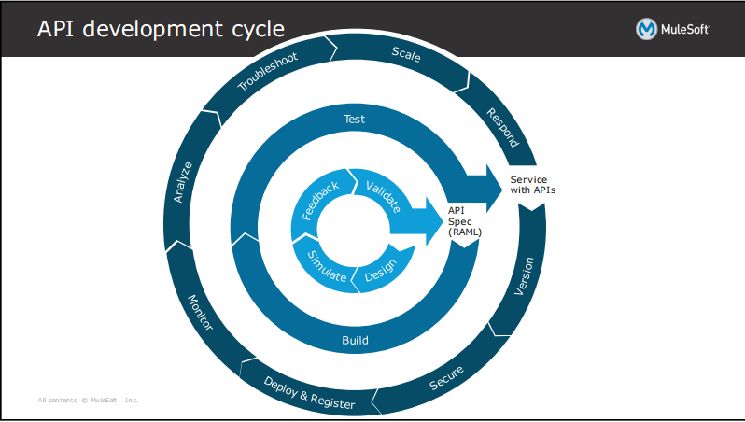
API lifecycle
Design, build, deploy, manage, and govern
Chinasofti MuleSoft Training 2017
Notes:
培训说明和Mulesoft总体介绍(15-25分钟)

Slide 11
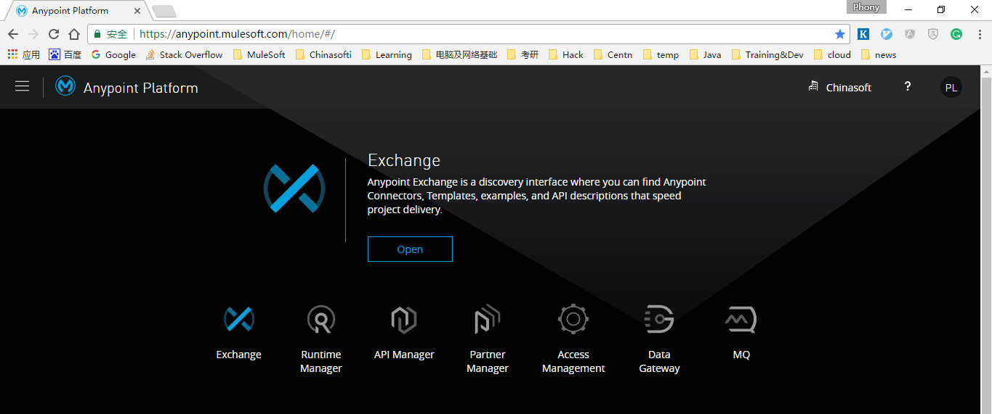
Anypoint platform
介绍Anypoint平台
地址: https://anypoint.mulesoft.com
Chinasofti MuleSoft Training 2017
Notes:
培训说明和Mulesoft总体介绍(15-25分钟)

Slide 12
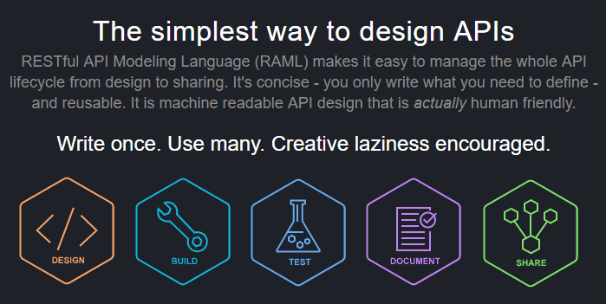
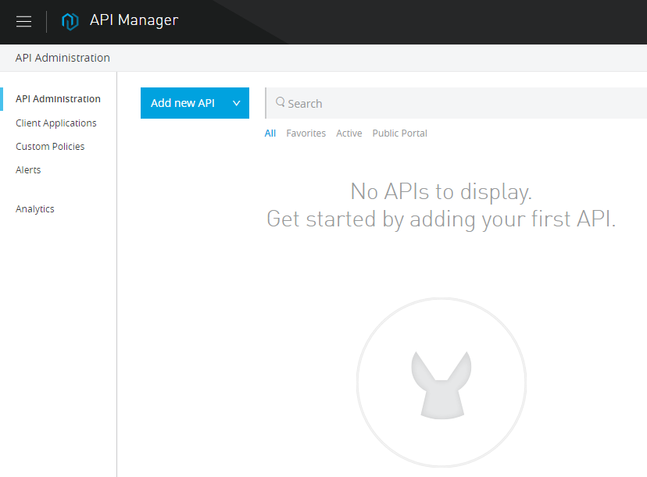
Design and deploy API without any code
RAML/API Manager/ API portal和介绍
Chinasofti MuleSoft Training 2017
Notes:
MuleSoft是一家提供基于云的应用集成服务商，成立于2006年，总部位于旧金山。公司的主打产品是 Anypoint 平台，可实现SaaS、SOA及API等的集成，也能实现本地系统与云，以及云与云服务的集成。该平台可以对企业的集成策略进行集中的设计和管理，并作为hub中心与各类端结点系统对接，将二维的点对点连接降低到一个维度，从而简化了集成的复杂性。
——36氪

Slide 13
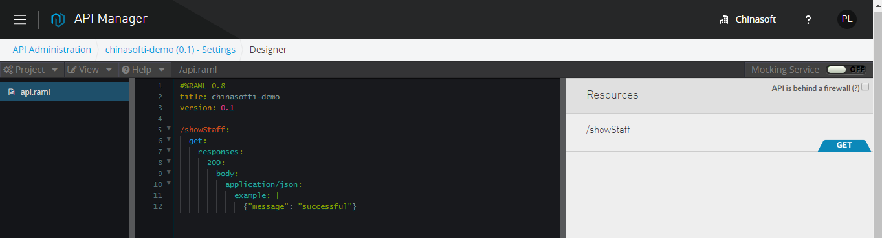
Design and deploy API without any code
Walkthrough API design
Chinasofti MuleSoft Training 2017
Notes:
MuleSoft是一家提供基于云的应用集成服务商，成立于2006年，总部位于旧金山。公司的主打产品是 Anypoint 平台，可实现SaaS、SOA及API等的集成，也能实现本地系统与云，以及云与云服务的集成。该平台可以对企业的集成策略进行集中的设计和管理，并作为hub中心与各类端结点系统对接，将二维的点对点连接降低到一个维度，从而简化了集成的复杂性。
——36氪

Slide 14
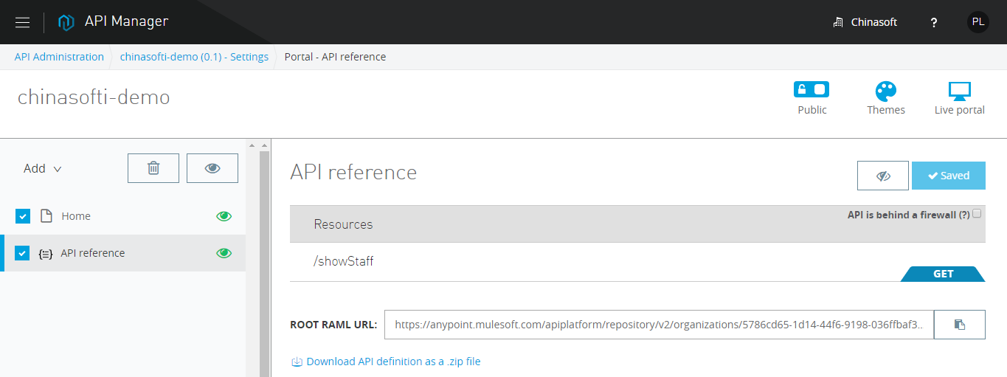
Design and deploy API without any code
API portal
Chinasofti MuleSoft Training 2017
Notes:
MuleSoft是一家提供基于云的应用集成服务商，成立于2006年，总部位于旧金山。公司的主打产品是 Anypoint 平台，可实现SaaS、SOA及API等的集成，也能实现本地系统与云，以及云与云服务的集成。该平台可以对企业的集成策略进行集中的设计和管理，并作为hub中心与各类端结点系统对接，将二维的点对点连接降低到一个维度，从而简化了集成的复杂性。
——36氪

Slide 15
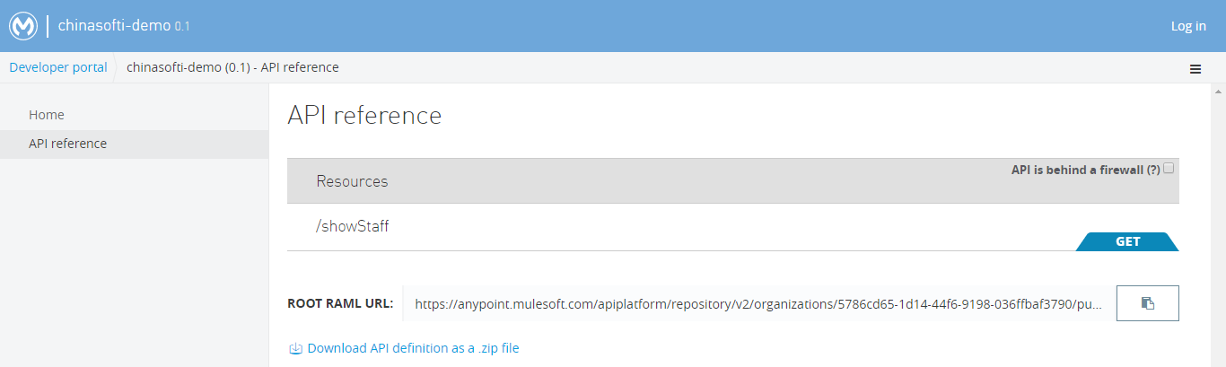
Design and deploy API without any code
API portal
Chinasofti MuleSoft Training 2017
Notes:
MuleSoft是一家提供基于云的应用集成服务商，成立于2006年，总部位于旧金山。公司的主打产品是 Anypoint 平台，可实现SaaS、SOA及API等的集成，也能实现本地系统与云，以及云与云服务的集成。该平台可以对企业的集成策略进行集中的设计和管理，并作为hub中心与各类端结点系统对接，将二维的点对点连接降低到一个维度，从而简化了集成的复杂性。
——36氪

Slide 16
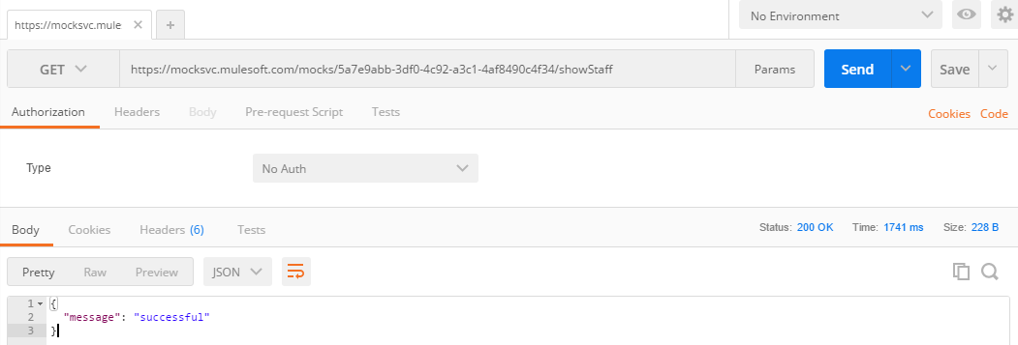
Calling mock service
使用postman访问服务
Chinasofti MuleSoft Training 2017
Notes:
培训说明和Mulesoft总体介绍(15-25分钟)

Slide 17
Thanks
API-Led 结束
Chinasofti MuleSoft Training 2017
Notes:
培训说明和Mulesoft总体介绍(15-25分钟)

